Slide 1








ULTRA EXCELLENCE
BUILDING CONTRACTING
Empower Your Vision
JiIfrasLrur:tube
.\1 citcil azlcc

Slide 2


UtTBA EXCELLENCE
Ultra Excellence Building Contracting L.L.C. (UEBCC)
We started on an ambitious vision to become a fast-growing construction contracting company in Dubai, having branch oflice in Fujairah and Shaljah. We have a 1:earn 1:a become a well-established business house in diversified fields of Construction which includes and not limited to Villa & Building construction, turnkey in1:erior fi1:out, MEP, infrastructure etc.
The company has a tremendous goodwill of the customers and associates. We have expertise, reach and financial strength to deliver the best solutions.
Sourcing the best talent from countries, UEBCC is a boast of Plethora of talents in virtually all ■
fields related to construction.
^
MISSION
No be able to meet the needs of their clients whilst exploring new opportunities and con- ducting business in a socially, economically and environmentally responsible manner, thereby creating value and sustainability for all their stakeholders."
vl5loN
To become pioneers in Building contracting in their field of expertise and from it expand to become a Mega Projects Contractor. This will be achieved through being daring and persistent in finding new business opportu- nities in Middle East. Promoting a culture of reliability, customer satisfaction and social integrity. Developing and Inspiring their workforce.

Slide 3










ULTR A EXC ELLENC E
BUILDING CONTRACTING
Our Team
Every member of our team — our greatest strength — is a skilled professional. It consists of Managers, Engineers, Architects, Designers, Supervisors and the technical team. Each one is an expert in the field, with valuable experience in providing creative interior design and project management solutions.
We make your goals our own and work with you to plan, implement and manage your project, ensuring it is running effectively, eGciently and delivers on time.
We keep ourselves abreast of the latest trends and developments in the industry. We conduct regular training to ensure the team stays up-to-date with HVAC, MEP, Green Building Concepts, Structure, Fire & Safety and so on. That also includes spiritual elements. If it is related to the field, we make sure we know about it.
OUR
PROCESS
Client Selection
Tender
Kick of Meeting
Engineering
Procurement
Execution
Handover

Slide 4




HOWWE WORK
ULTR A E XC ELLE N C E
BUILDS NG COHT g ACTING
Qua lity
Our fundamental obligation is to provide a construction service which complies with construction regulations, international and Ical legislation and, of course, client requirements. The Company has a duty of care towards its employees, suppliers and
subcontractors, all other external companies involved in the building process, the end-users and the environment as a whole.
We have established a sophisticated Management System, with trained staff and operatives, and can allmate resources, equipment and plant eGciently. Using appropriate key performance indicators for sites and personnel, we are able to regularly monitor and evaluate its effectiveness.
A trained, confident and informed workforce is the key to our success. We are fully committed to achieving customer satisfaction by maintaining the highest possible levels of quality and through the punctual completion of our projects.
HSE
The health and safety of our employees and everyone else affected by our activities along with the protection of the environment in which we operate is fundamental to the success of our business. The health and safety of our people and local communities as well
as the environment in which we operate always comes first in UEBCC.
Our philosophy is to continually strive for a ’Zero Harm‘ environment. Accordingly, we implement comprehensive health, safety and environmental policies and prmedures throughout our operations, in the belief that all incidents are avoidable.
Technology
We look forward to entering the next phase of our growth by driving eGciency through digitally integrated prmesses. There is significant development in the technology sector that can help UEBCC to become more streamlined and eGcient.
The UAE has a strong vision for developing smarter communities that are powered by cutting-edge technology solutions. UEBCC is adopting new technologies that add value to UEBCC's partners, customers, and employees.
Technologies which we are implementing are disrupting traditional models for planning, staGng, monitoring, and delivering projects as the physical world becomes increasingly digitized.

Slide 5






ULTRA 5XC5LL5NC5
BUILDING CO MTRACJ ING
CERTIFICATION
Our Quality and HSE management system is accredited to international standards
SUSTAINABILITY
Our sustainability strategy,"Constructing for a Sustainable Tomorrow" emphasizes on delivering sustainable construction services which benefits our employees, the clients, environment, wider community and other project stakeholders.
UEBCC constantly aims to construct sustainable projects and a few of them have received leading green building certifications, the Leadership in Energy and Environmental Design (LEED) and Estidama certification.
0663413131
030363 2588

Slide 6







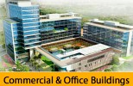




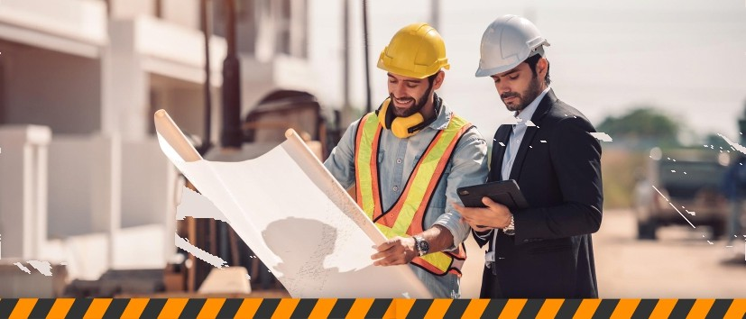
ULTRA EXCE LLEN CE
BUILDINC CONT 8ACTINC
WHAT WE DO
CIVIL CONSTRUCTION

Slide 7
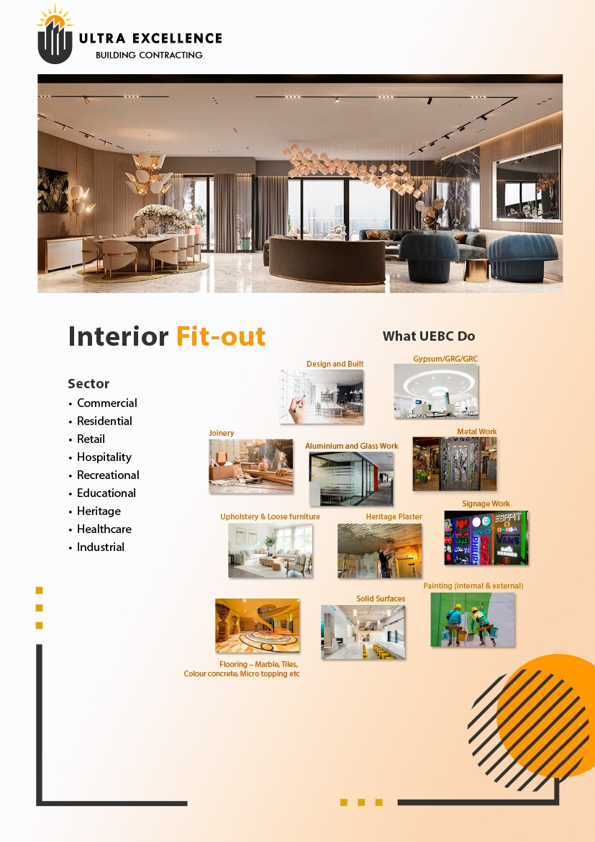

Slide 8

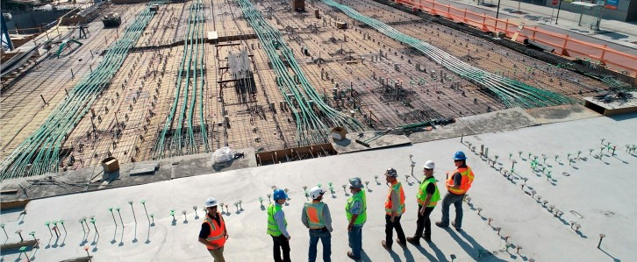
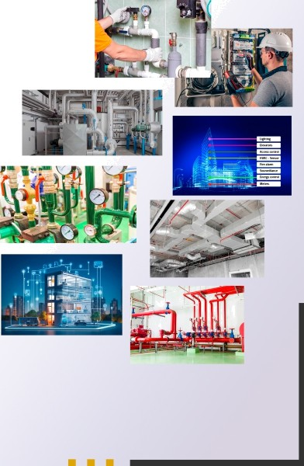
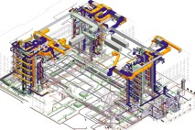

Electromechanical Works (MEP)
ULTRA sxcsLLENcs
BUILI7I¥4G CONTRACTING
What UEBC Do
Electrical
Plumbing
Building Management System
ELV System
Fire fighting System
fire Alarm System
Instrumentation and ITWork

Slide 9

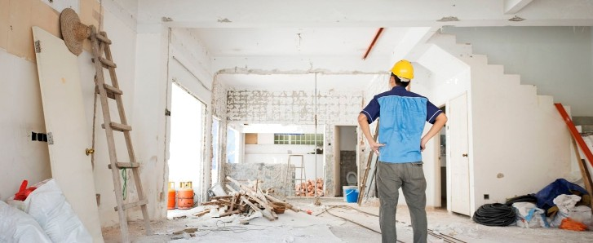








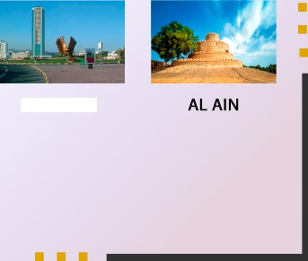

ULTRA EXCELLENCE
BUILDING CONTRACTING
Renovations, Remodelling &
What UEBC Do
Home/Flat renovations
Kitchen renovations
Bathroom Renovations
Villa Renovations
Villa and Apartment Remodelling
Plumbing Services
AC maintenance
Space Design
Landscaping Work
Our Locations
DUBAI
SHARJAH
FUJAIRAH

Slide 10


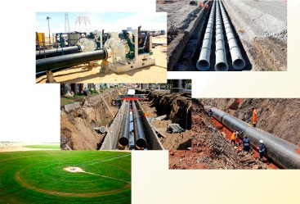


ULTRA EXCELLENCE
BUILDING CONTRACTING
Infrastructure
Stormwater, Sewerage, Irrigation, Water Pipeline
Surveying & Design
Mechanical & Manual Excavation
Pipe laying (UPVC, AC, GRP, GRC,
HDPE, DI, CS etc)
Fitting installation
Mechanical corrosive protection
Chamber construction.
Hydrostatic Pressure Testing
Disinfection & Flushing
Maintenance work
Oil & Gas Work
Manpower Supply
Fabrication & Erection of Structures,
Piping, Tanks, Vessels etc
Welding
Civil Structures
Fitting installation and Testing
Maintenance & Operation Services

Slide 11


ULTR A E XC ELLE NC E
BUILDINC: CON TR ACT ING
056 341 3131
0S0 363 2688
wow.uItraexceIIence.me
WHY SHOULD CHOOSE US?
Customer satisfaction is a top priorité for us. We go above and beyond to provide exœllent serviœ and products, as well as stay in constant communication with emery customer. We are œmmitted to satisfying and retaining our Clients who appreciate the importanœ of saving time, which can eventually lead to more business opportunities. Our qualified personnel, profèssional attitude and teamwork are essential elements in delivering good services. We carefully plan and organiæ projects, with the combined efforts of all stakeholders, resuhing in a successful outcome.
Ultra Excellence Building Contracting prides itself on maintaining its reputation as the leading Construction, Maintenance, and Repairing Solution Company in the country. We are committed to upholding our core values of trustworthiness,excellence, skill and leadership.
Professional and Experienced Staffs
Giving Proper Estimate
On-Time Work Finish
Transparency In Billing
No Visiting Charge Same Work For 15 Days
Attend Small and Big Job Same Interest
Background Verified all Our Ultra Excellence Building Contracting
Maintaining our dedication
Constantly striving to exceed expectations
Constantly improving the quality of our work

Slide 12



ULTR A E XC ELLE N C E
BUILDS NG COHT g ACTING
Contact Us
Du bai, Sharja h, Fuja irah, AI Ain
056341 3131,0503632688
info‹a›uItraexceIIence.me
www.uItraexceIIence.me

